Slide 1
Flooring Orders Project
github.com/abitabir/FlooringMastery

Slide 2
Project Overview
• A Java-based flooring order management system to allow users to manage customer orders, calculate costs, and store data in a database
• Technologies used:
• Java (Spring Framework)
• MySQL (Database)
• JUnit (Testing)
Notes:
Developed a console-based Java application for managing flooring orders
Designed a relational database (MySQL) for storing orders, taxes, and products
Employed Spring Framework for dependency injection, reducing tightly-coupled components and boilerplate code
Utilised JUnit for partially test-driven development

Slide 3
System Architecture
• Model-View-Controller (MVC) & N-Tier Architecture:
• View: Handles user interaction
• Controller: Manages business logic flow
• Service: Applies business rules and validation
• DAO (Data Access Object): Interacts with the database
• Model: Defines the data structure
Notes:
Implemented a multi-layered architecture (MVC + DAO) for modularity and maintainability

Slide 4
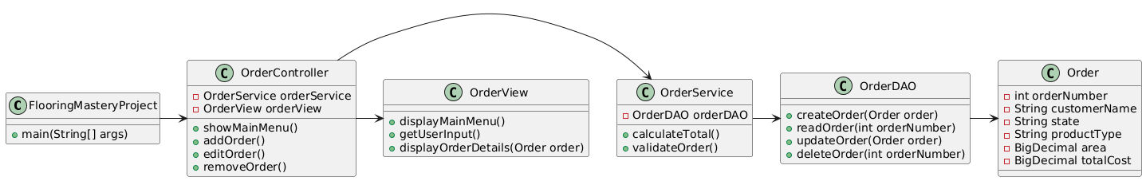
System Architecture
UML Class Diagram

Slide 5
Core Features
• User IO Operations
• Display orders for a given date
• Add, edit, and remove orders
• Takes in user inputs and validates them
• Order Date, Customer Name, State, Product Type, and Area

Slide 6
Core Features
• Business Logic
• Products, tax rates and order details dynamically retrieved
• Order cost calculated based on tax and product pricing
• Material Cost = (Area × Cost Per Square Foot)
• Labor Cost = (Area × Labor Cost Per Square Foot)
• Tax = (Material Cost + Labor Cost) × (Tax Rate/100)
• Total = Material Cost + Labor Cost + Tax

Slide 7
Core Features
• Data Storage
• Orders stored in MySQL with auto-incremented ID

Slide 8
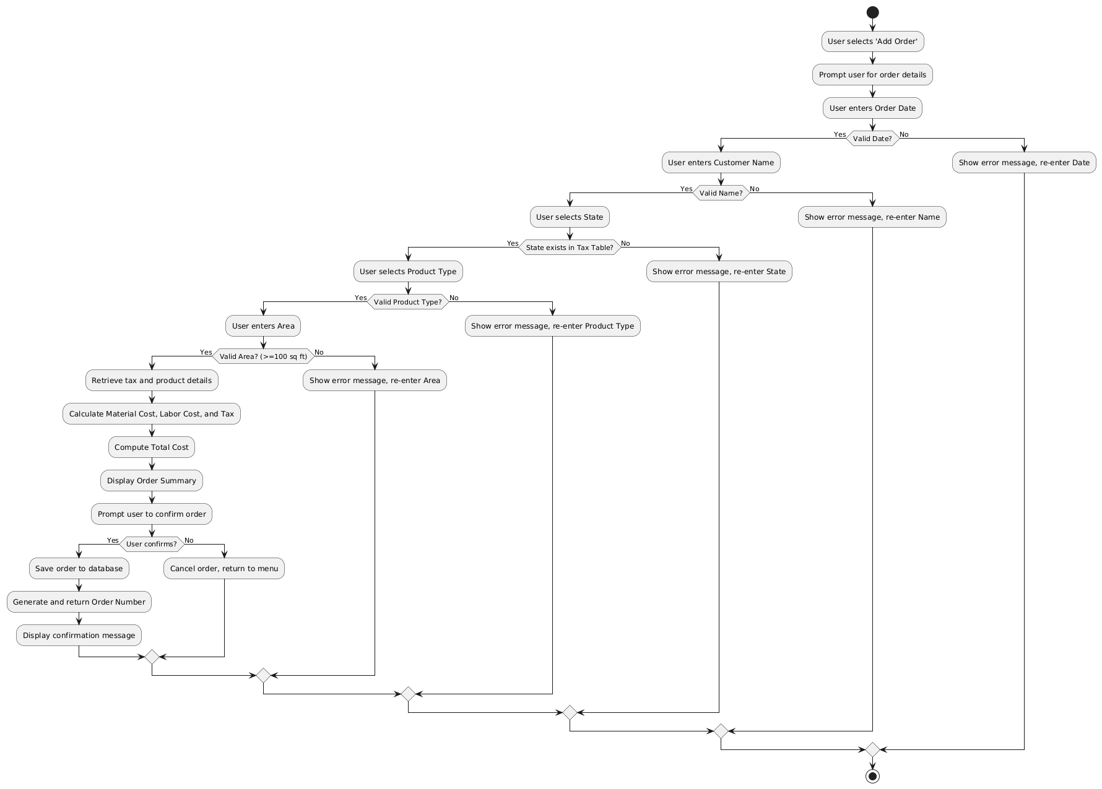
Core Features
UML Activity Diagram
Notes:
Ensured input validation and error handling to maintain data integrity

Slide 11
Database Design
• Tables:
• Orders: Stores customer orders with calculated totals
• Tax: Holds state tax rates
• Products: Lists flooring materials and pricing
• Default Data (Examples):
• Orders: Ada Lovelace | CA | Tile | 249 sq ft | $2381.06
• Tax: California (CA) – 25.00%
• Products: Tile – $3.50/sq ft, $4.15 labor/sq ft

Slide 12
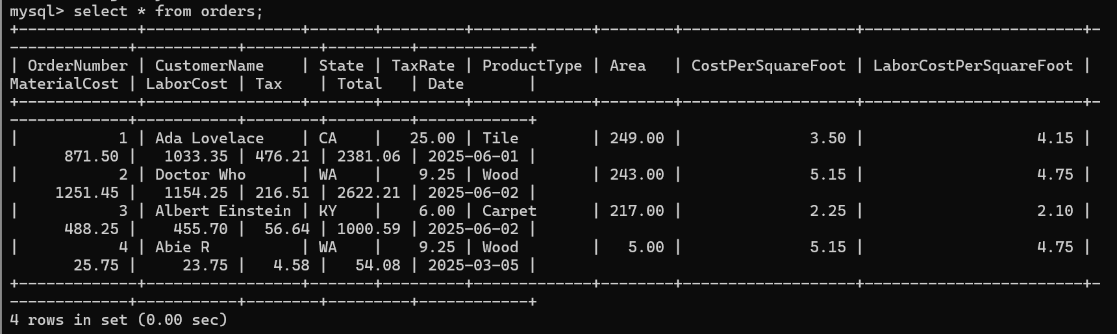
Database Design

Slide 13
Order Operations
• Add an Order
• Input validation ensures correct data entry
• Order total is calculated dynamically
• Order is stored in the database upon confirmation
• Edit an Order
• Users can update customer name, state, product type, or area
• Recalculation occurs as key details can change
• Remove an Order
• Order retrieval by date and ID for deletion confirmation

Slide 14
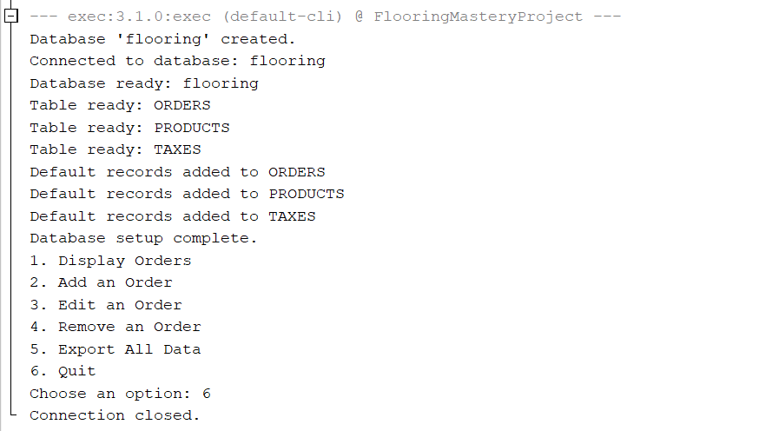
Order Operations

Slide 15
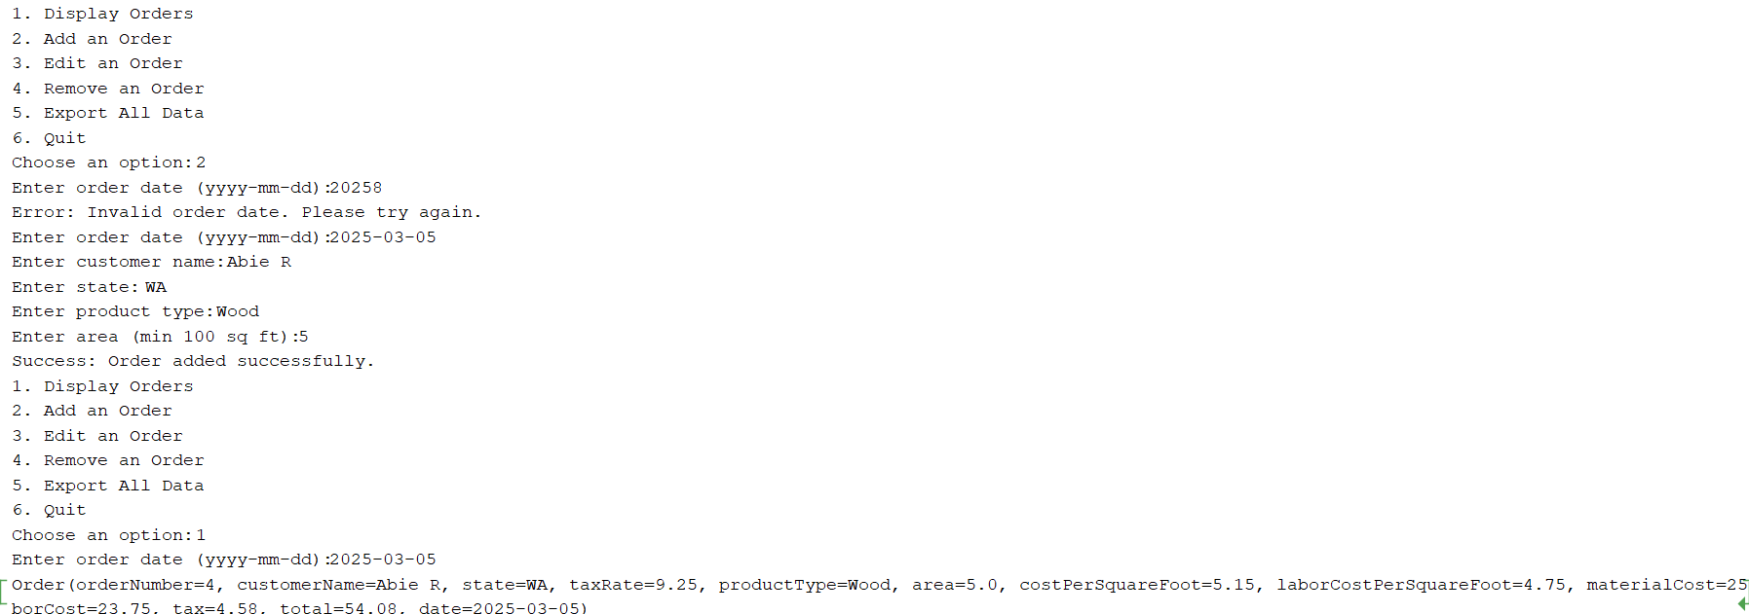
Order Operations

Slide 16
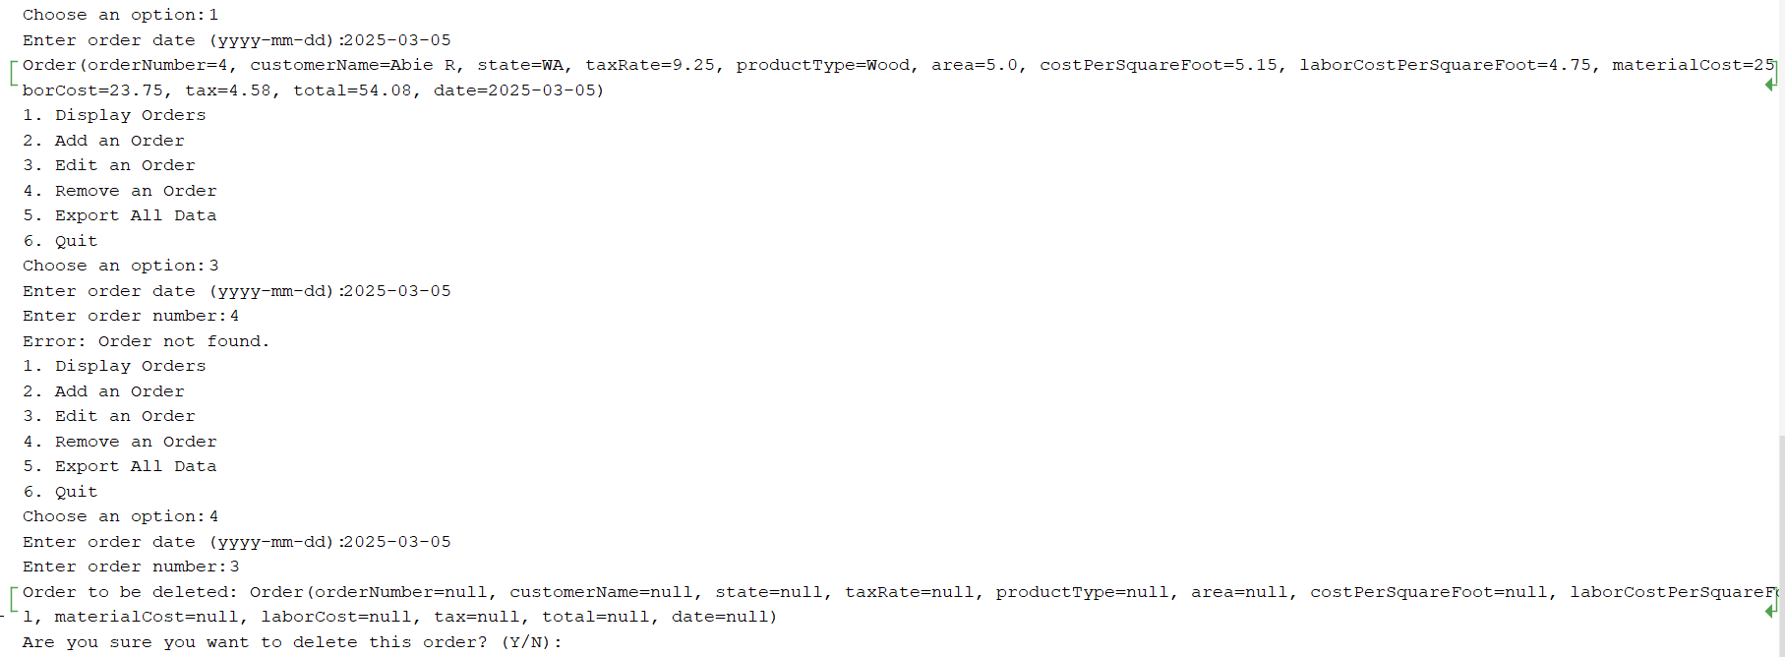
Bugs & Fixes

Slide 17
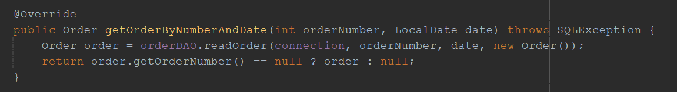

Bugs & Fixes

Slide 18
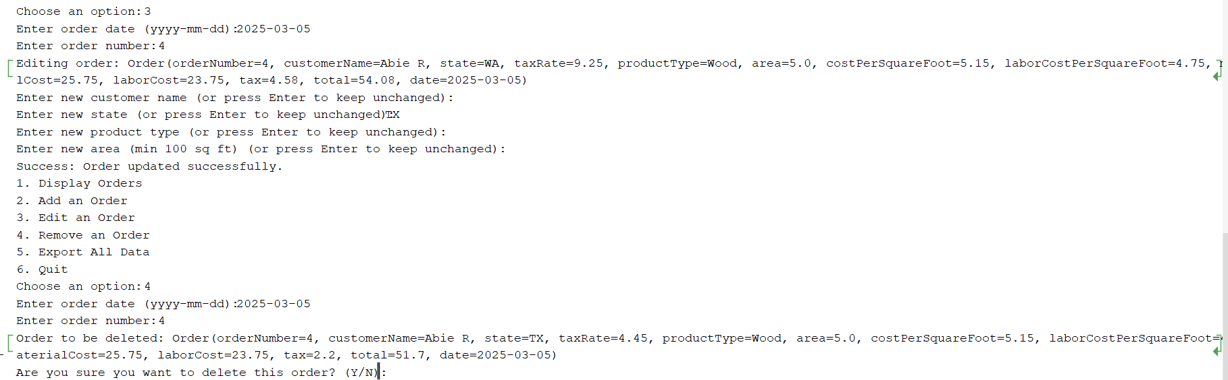
Bugs & Fixes

Slide 19
Future Improvements
• More JUnit Test Coverage
• Extending test cases for DAO and service layers
• Returning Order Number upon Creation
• Adapting OrderService to return the generated ID
• Data Export Functionality
• Implementing CSV/JSON export
• Optimise editing an order
• Recalculate whole order only if key details change

Slide 20
Questions
Thank you for listening!

